Slide 1
Target Detection Using Algorithmic Matter
Rebecca Martin

Slide 2
Introduction
Algorithmic matter are systems of simple particles that work together to achieve complex tasks
Syncells are micro-scale robots
Limited computation
O(n) memory
Target Detection and Convergence Problem
Applications in medicine

Slide 3
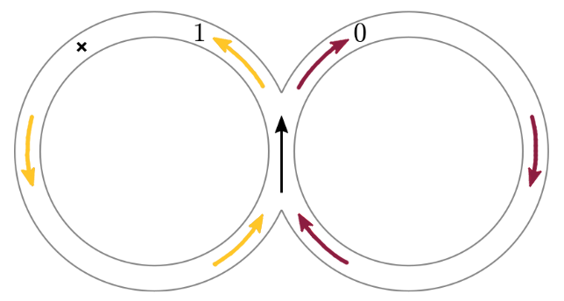
Related Work
Multi-agent Markov Decision Process
Approximate Bayesian filter
Relies on communication
Could withstand noise
Makes assumptions about how often particles encounter each other

Slide 4
Problem Statement
Given a graph with n vertices, one target edge, and f(n) particles, an algorithm solves an instance of the Target Detection and Convergence Problem if it causes at least 80% of the particles to discover the target within O(n²) timesteps, while taking into account the limited computation and memory constraints of Syncells.

Slide 5
Model
Environment graph
Strongly connected
Random
Directed
Particle capabilities
Can control direction
Spatial awareness
Can generate random numbers
Can communicate

Slide 6
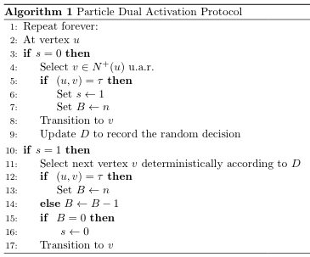
Algorithm
Random mode
Move randomly
Use policy to keep record
Success bit: 0
Policy mode
Move according to policy
Success bit: 1
Counter can never reach 0
Communication
Must be at same node
One particle must be successful

Slide 7
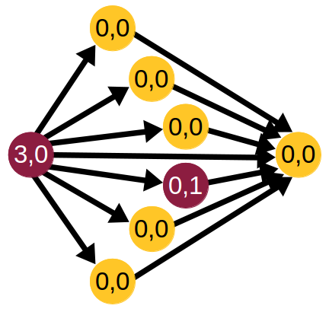
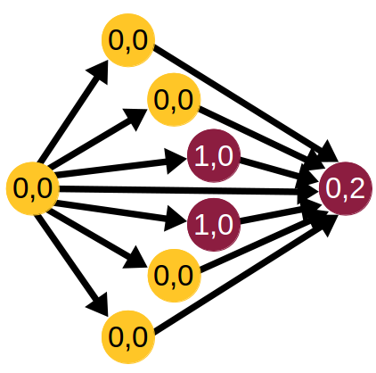
Communication
Successful particle shares policy with unsuccessful particle
If both successful, receiver and transmitter chosen at random

Slide 8
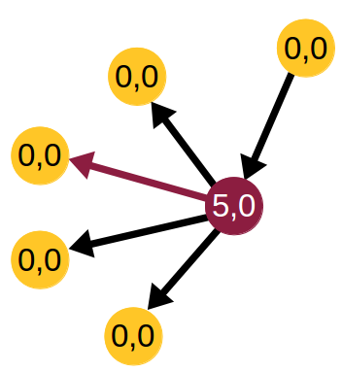
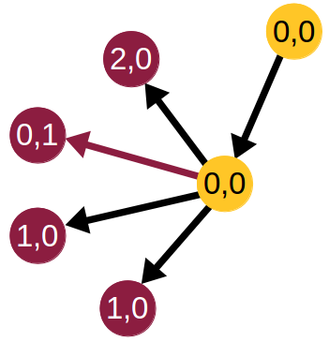
Experiments
External tool: graph-tool
Varying particle count as a function of graph size n
log(n)
n
nlog(n)
n²

Slide 9
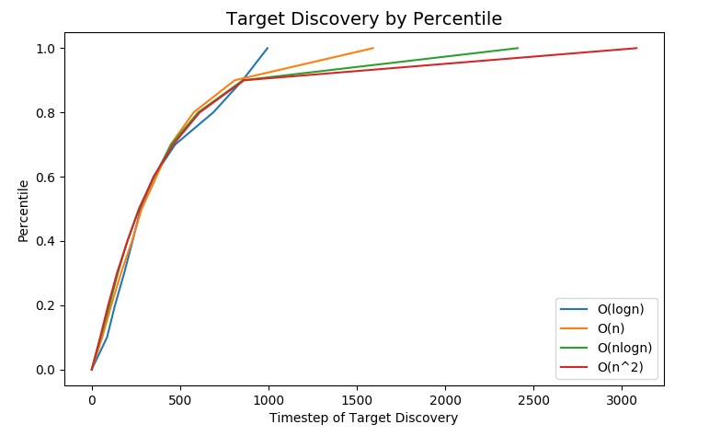
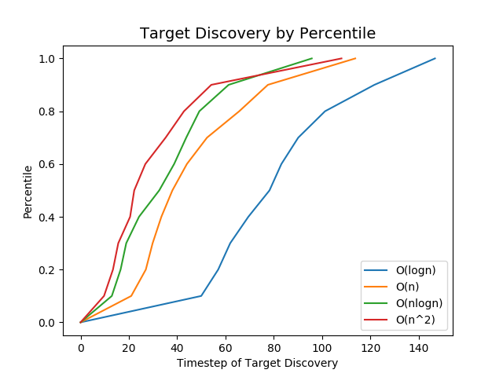
Results
Recorded the distribution of target discovery times
Left is without communication, Right is with communication

Slide 10
Future Work
Extension of Current Approach
Add in third state to differentiate communication
Add parallelization to enable testing on larger graphs
Formally derive bound on solution run time
New Approach
Policy-based solutions make infeasible assumptions
Leave markers in environment
Chemical presence could be used as trail signs

Slide 11
Thank You!

